Slide 1

.NET Bootcamp

Slide 2
Overview
Joins
Installing SQL Server
ORMs
Entity Framework Core
For next class

Slide 3
Joins
Joins are a way to link data table
Inner Join
Only returns data that is in both tables
Outer Join
Returns all data from one table and any data matching in second table
Left Join
Returns all data from the left table and any matching data from the right table
Right Join
Returns any matching data from the left table and all data from the right table
Full Join
Returns all data from both the left table and right table

Slide 4
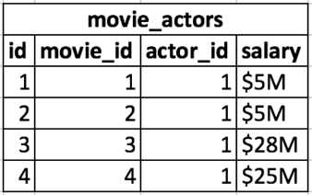
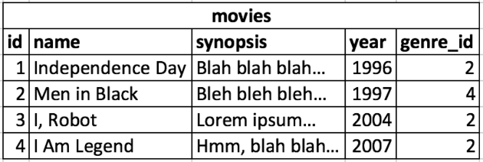
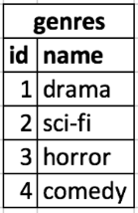
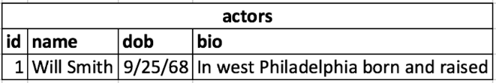
Movies Database Tables

Slide 5
SQL - Inner Join
SELECT <TABLEx>.<COLUMNS> FROM <TABLE1> [INNER] JOIN <TABLE2> ON <CONDITION>

Slide 6
SQL – Left Outer Join
SELECT <TABLEx>.<COLUMNS> FROM <TABLE1> LEFT [OUTER] JOIN <TABLE2> ON <CONDITION>

Slide 7
SQL – Right Outer Join
SELECT <TABLEx>.<COLUMNS> FROM <TABLE1> RIGHT [OUTER] JOIN <TABLE2> ON <CONDITION>

Slide 8
SQL – Full Outer Join
SELECT <TABLEx>.<COLUMNS> FROM <TABLE1> FULL [OUTER] JOIN <TABLE2> ON <CONDITION>

Slide 9
Installing SQL Server
https://www.microsoft.com/en-us/sql-server/sql-server-downloads
SQL Server 2019
Install the Express Edition

Slide 10
What is an ORM?
ORM is an Object-Relational Mapper
Object-relational mapping is a technique of connecting data stored in a relational database (SQL Server) to the objects defined in the application

Slide 11
Why use an ORM?
Makes life way easier
Traditionally, you’d query database and manually set the data returned to your object

Slide 12
Entity Framework Core
Entity Framework Core is a .NET ORM built by Microsoft
It’s lightweight, extensible, open-source, and cross-platform
There are other ORM tools out there such as NHibernate, Dapper, etc
Works with many relational databases such as SQL Server, Sqlite, InMemory, PostgresSQL, MySQL, etc

Slide 13
Installing EF Core
dotnet add package Microsoft.EntityFrameworkCore.SqlServer
dotnet add package Microsoft.EntityFrameworkCore.Tools
dotnet add package Microsoft.EntityFrameworkCore.Design

Slide 14
Using EF Core
EF Core can either be code-first or database-first
Code-first relies on the application creating and managing the database schema
Database-first relies on the database schema already existing and the entities are reverse-engineered from it
We’ll use the code-first approach

Slide 15
Using EF Core - Models
EF Core models are a conceptual model of an application
Models are a collection of classes that represent an entity within the application
The model structure usually closely matches the schema of the database
If application model is different than the schema, it can be mapped (either using annotations or fluent API)

Slide 16
Using EF Core - DBContext
DBContext class represents a sessions with a database and provides an API for communicating with the underlying database
It handles:
Database connections
Data operations (querying/persisting data)
Change tracking
Model building
Data mapping
Object caching
Transaction management

Slide 17
DBContext – Querying Data
Querying data is done via LINQ
LINQ, or Language INtegrated Query, is a set of technologies based on the integration of query capabilities directly into the C# language
Refer to the Codecademy course on LINQ
var objects = context.Object.Where(o => o.property == value).ToList();

Slide 18
DBContext – Adding data
Adds data via the Add or AddRange method
context.add(object); context.SaveChanges();

Slide 19
DBContext – Modifying data
Updates data via the Update or UpdateRange method
context.Update(object); context.SaveChanges();
Updates when changes are made to the object
context.add(object); context.SaveChanges(); object.property = newvalue; context.SaveChanges();

Slide 20
DBContext – Removing data
Updates data via the Remove method
context.Remove(object); context.SaveChanges();

Slide 21
Using EF Core - DbSet
The DbSet class represents a collection of a given entity within the model
It is the gateway for database operations against the entity
public class object { … } public class context : DbContext { public DbSet<object> Objects { get; set; } }

Slide 22
Using EF Core - Relationships
EF Core supports one-to-one, one-to-many, and many-to-many relationships
Your model should already be built in a way that handles these relationships
public class Object { … public AnotherObject x { get; set; } } public class AnotherObject { … }

Slide 23
Using EF Core – Connection Strings
Connection strings contain the information about the data source that EF is connecting to
optionsBuilder.UseSqlServer( @"Server=SERVERNAMEHERE;Database=DATABASEHERE;Integrated Security=True;");

Slide 24
Using EF Core – Migrations
Migrations is a tool to help keep your database in sync with your model
dotnet ef migrations add <NAME> dotnet ef database update

Slide 25
Further Reading
Learn Entity Framework Core
https://www.learnentityframeworkcore.com/
Entity Framework Docs
https://docs.microsoft.com/en-us/ef/core/
Codecademy: Introduction to LINQ
https://www.codecademy.com/courses/learn-c-sharp/lessons/csharp-linq/exercises/introduction-to-linq
LINQ Docs
https://docs.microsoft.com/en-us/dotnet/csharp/programming-guide/concepts/linq/

Slide 26
For Next Class
Continue to break down your application into manageable tasks and create issues in GitHub

